Slide 1
Predicting Volatility in US Electricity Prices
Miles Franklin, David Harper,
Adam Goldstein, Himanshu Ghritalhre

Slide 2
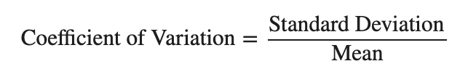
Recap
Target
The goal of this project is to produce a model predicting the price volatility of electricity for a given year. We measure the volatility using the Coefficient of Variation, to normalize the data and facilitate state to state comparisons.
Features
Futures Market Volume
How well do market participants understand market direction?
Drought and Temperature Trends
Are the effects of climate patterns felt more by renewable sources?
Distribution of Fuel Sources in a State
What percent of production is from coal, solar, etc.?
Consumption measured in electricity sales
Do states that have more businesses and industry have a less stable price?

Slide 3
Phase 2 Project Overview
Dataset
Expanded dataset from 2008-2020 to 2001 - 2020
Backfilled electric accounts for RES, COM, and IND population
RES - US Census
COM and IND - Statistics of U.S. Businesses (SUSB, a program run by US Census)
Started modeling with Decision Tree and Linear Regression
Explored Research Questions

Slide 4
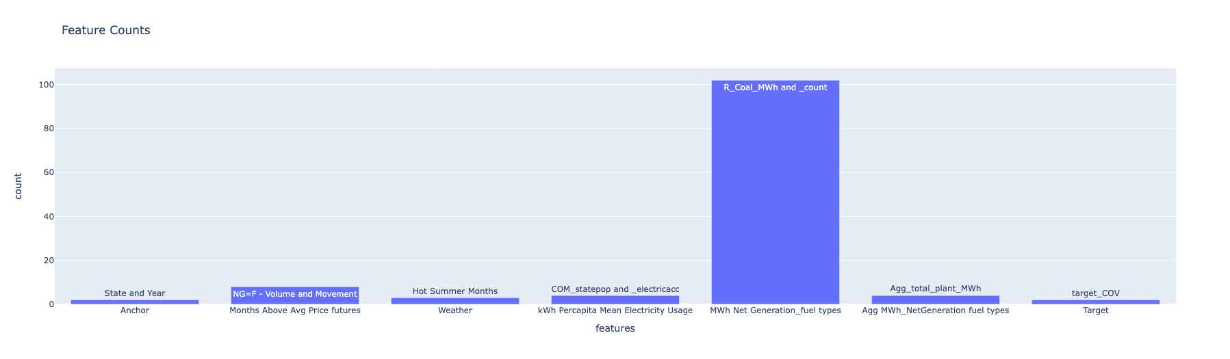
Dataset
Rows = 50_states * 20_years (2001-2020) = 1000
Features - 123 (Fuel Type - 37 unique)

Slide 5
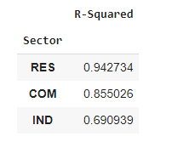
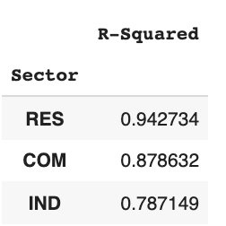
Back Fill Model
Problem - Electric Accounts data was not recorded for 2001-2008
Solution - Predict using other yearly data with greater than 0.75 R^2
Approach 1 - US Census
Approach 2 - SUSB Employment Count
≈ + 0.02
≈ + 0.09
Notes:
Statistics of U.S. Businesses (a program run by US Census)

Slide 6
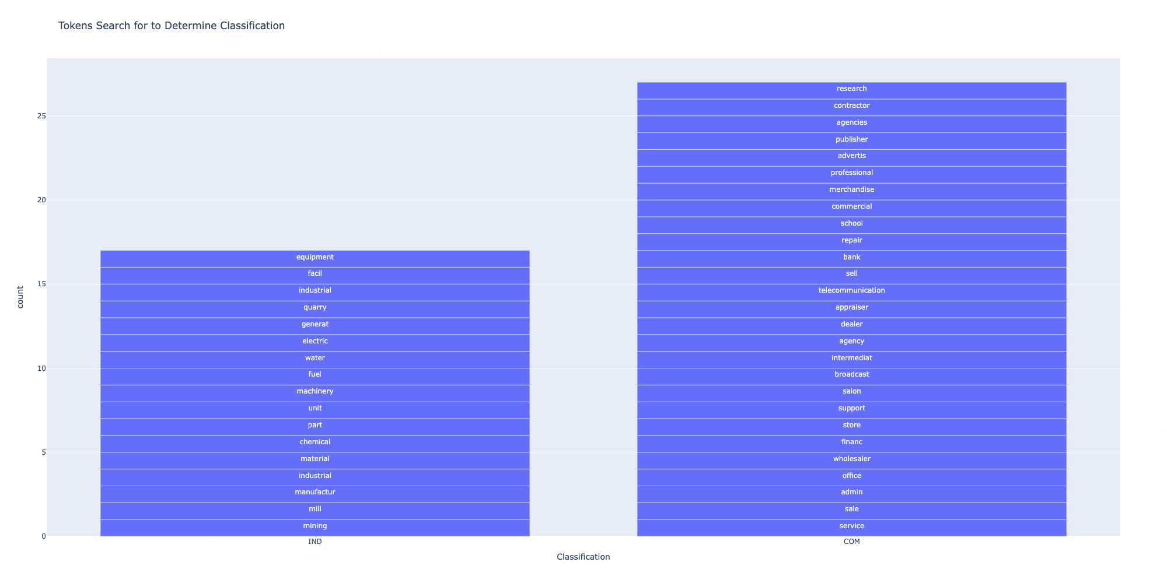
BackFill 2001-2008 - Approach 2
Was given a description of types of business
Made assumption on key words for IND and COM classification
Used a string search so plurals, prefixes, and suffixes did not impact the classification
Ex. Description
Accommodation & foodservices
Ex. Description
Mining

Slide 7
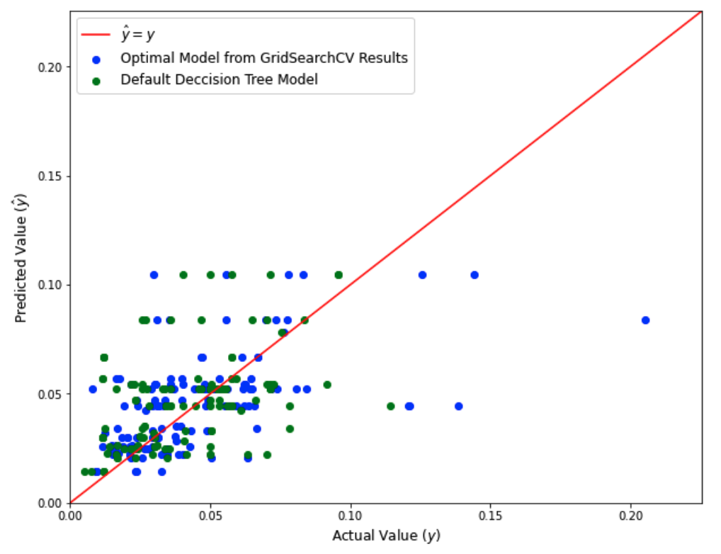
Decision Tree Regression Model
Grid Search Cross Validation for parameter optimization
Criterion (Loss Function)
Max Number of Features
Max Tree Depth
Minimum Number of Sample per Leaf
 | R^2 | Adjusted R^2 | MSE
Optimal Model from GridSearchCV Results | 0.2715 | -9.4416 | 0.0006
Default Parameters | 0.1139 | -11.70 | 0.0007

Slide 8
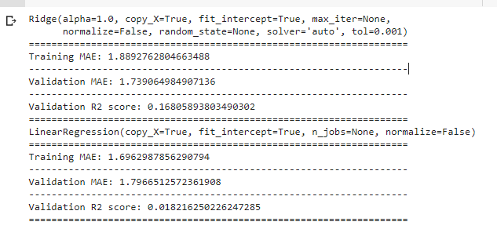

Ridge Regression
Feature Filtering
Comparing different models
Dealing with multicollinearity

Slide 9
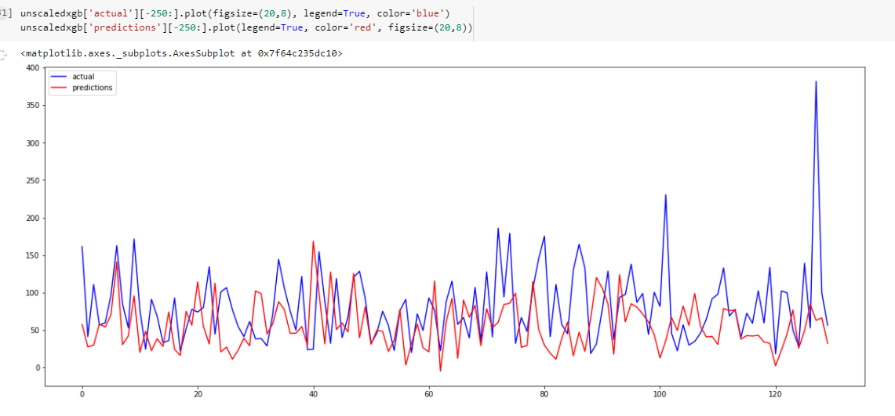
XGB REGRESSOR

Slide 10
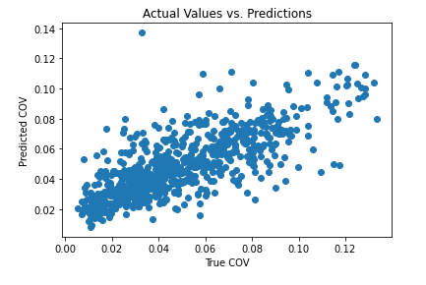
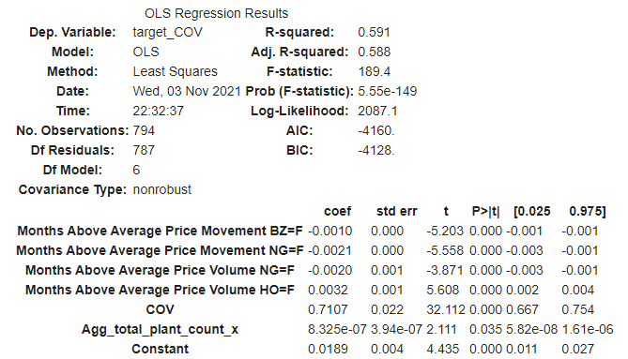
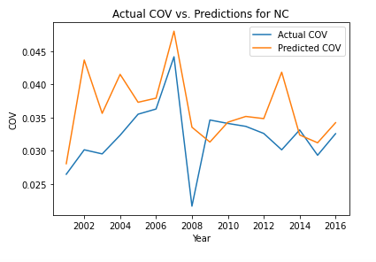
Plain Linear Regression Model
MSE -> 0.0003 ; Adjusted R-squared -> 0.588

Slide 11
Next Steps
Data Backfill
Improve accuracy of word classification by using lemmatization before searching
Dataset Engineering to Improve Model Performance
Sampling
Synthetic Minority Over-Sampling Technique (SMOTE) for Regression
Feature Engineering
Reduce Plant Fuel Type by aggregation categories. Ex. Coal, Biomass
Remove features based on thresholds of correlation. Ex. corr > list(0.30,0.40,...)
Modeling
Reframe problem to classification where classes are ranges of COV (i.e [0.05 - 0.10])
Evaluate what features are the strongest for our model (i.e LR - Weights)
Logging - Log performance and model metadata to understand experiments overtime

